Slide 1
Employee Data Analysis using Excel
STUDENT NAME: V.Deepika
REGISTER NO:
DEPARTMENT: B.Com(General)
COLLEGE Name: Valliammal college for women

Slide 2
PROJECT TITLE
Employee Performance Analysis using Excel

Slide 3


AGENDA
Problem Statement
Project Overview
End Users
Our Solution and Proposition
Dataset Description
Modelling Approach
Results and Discussion
Conclusion
3/21/2024 Annual Review

Slide 4

PROBLEM STATEMENT
Utilize Excel to efficiently analyses employee data by leveraging the Function such as PIVOT TABLES, and conditional formatting.
The enables the identification of key trends, such as current Employees rates, performance levels.
Decision-making processes by visualization this data through Pie chart

Slide 5

PROJECT OVERVIEW
This project focuses on analyzing employee data to identify trends and insights that can drive better decision.
Excel will be used to clean, organize, and visualize key metrics such as Employee demographics, performance, and mention rates.
The analysis will highlights areas of improvement in workforce management helping to optimize resource allocation.
Outcomes will include detailed reports and dashboard for management
Review:
The finding aim to support strategic Planning.

Slide 6



WHO ARE THE END USERS?
The end users of the employee data employee data analysis are HR Managers team leads and senior management.

Slide 7

OUR SOLUTION AND ITS VALUE PROPOSITION
Conditional formatting – highlights missing cells
Filter – helps to remove the empty cells
Formulas – helps to identify the performance of employees
Pivot table – helps summarize
Pie chart – shows the data

Slide 8
Dataset Description
1. Employee ID
2. First name
3. Last name
4. Business unit
5. Employee classification type
6. Employee type
7. Gender
8. Performance score
9. Current employee rate
10. Performance level

Slide 9

THE "WOW" IN OUR SOLUTION
Performance level:
=IF(Z8>=5,”VERYHIGH”,IF(Z8>=4,”HIGH”,IF(Z8>=3,”MED”,IF(Z8>=2,”LOW”))))
3/21/2024 Annual Review
9

Slide 10
MODELLING
DATA COLLECTION:
*Identification
*Gathering
*Preparation
DATA CLEANING:
*Standardization
*Correction *Validation
Summary:
Data analysis involves examining, transforming, and modeling data to
Extract insights , identify patterns, and support decisions-making.
10

Slide 11
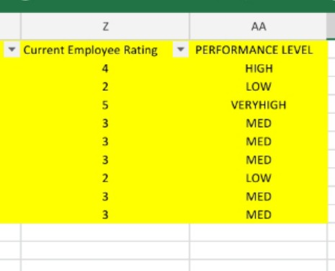
RESULTS
Employee performance level
11

Slide 12
conclusion
IN CONCLUSION, the employee data analysis conducted using Excel
Provided valuable insights into workforce trends enabling more
Informed decision-making.
The use of Excel allowed efficient data organization, visualization and reporting, ultimately helping to enhance HR strategies, improve
and employee satisfaction and optimize overall organizational performance.

